Slide 1
MEIOSIS
&
Sexual Life Cycles
Campbell
Chapter 13

Slide 2
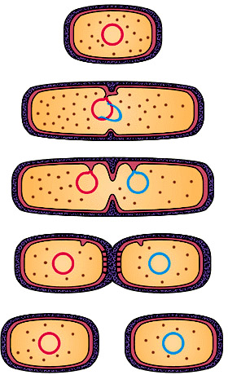
ASEXUAL REPRODUCTION
One parent alone produces offspring
Offspring inherits same # of chromosomes (& genes on it)
Theoretically, the offspring is a “clone” of its parent
Binary fission
Basically mitosis & cytokinesis (for eukaryotes)

Slide 3
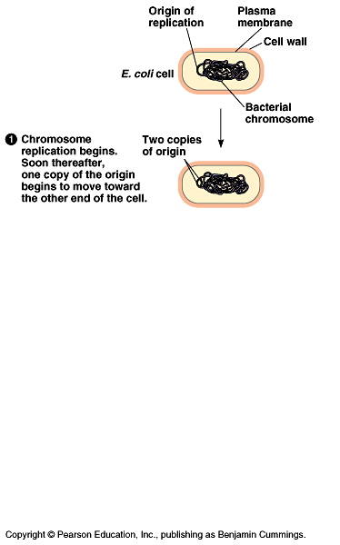

Slide 4
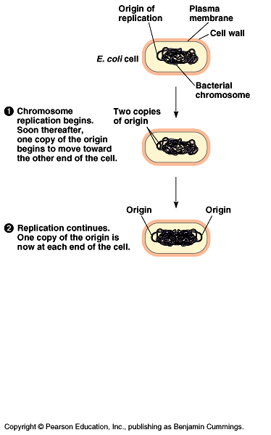

Slide 5
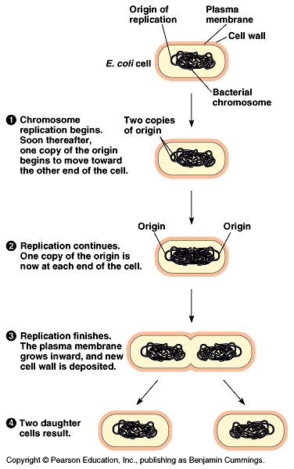

Slide 6
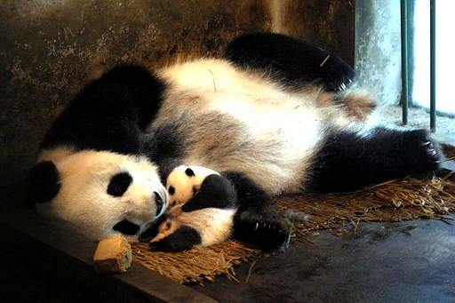
Sexual Reproduction
Involves:
Meiosis
Production of gametes
Fertilization
*Offspring has
pairs of new
chromosomes-
one set from each
parent

Slide 7
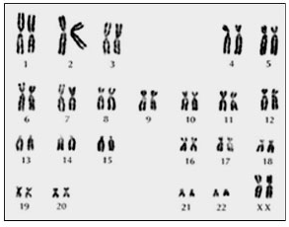
The Human Genome
23 pairs of chromosomes
Pairs 1-22: AUTOSOMAL chromosomes
Pair 23: SEX chromosomes
Paired chromosomes-”HOMOLOGOUS” chromosomes
Homologous-relatively same
size & shape
Pair 23 different for males

Slide 8
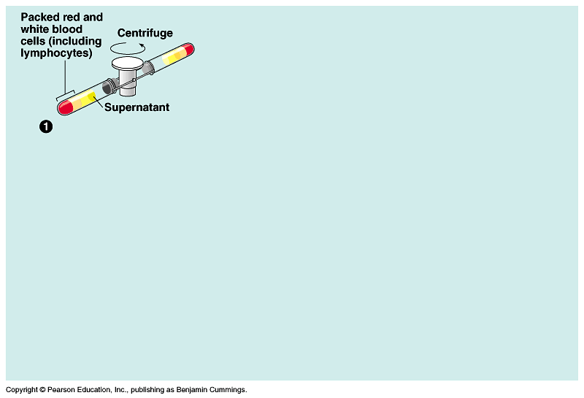

Slide 9
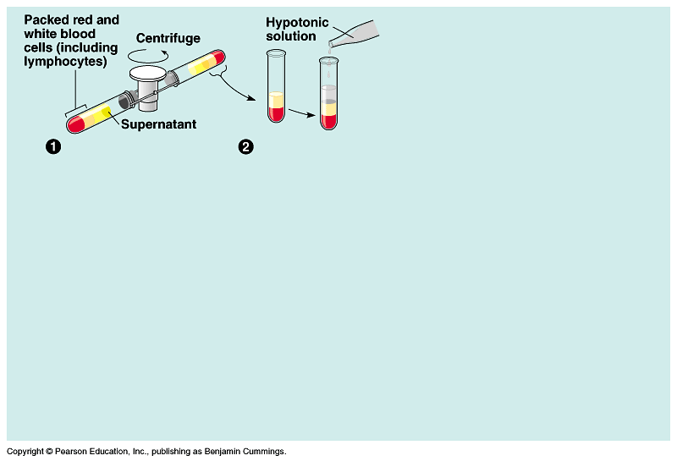

Slide 10
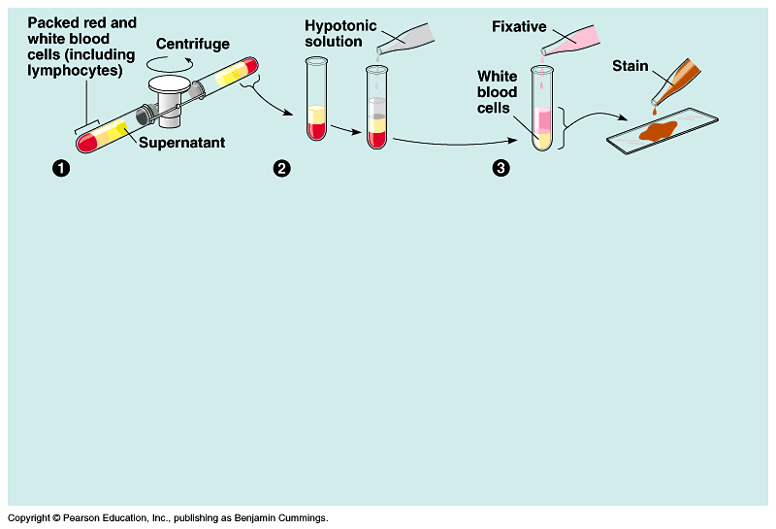

Slide 11
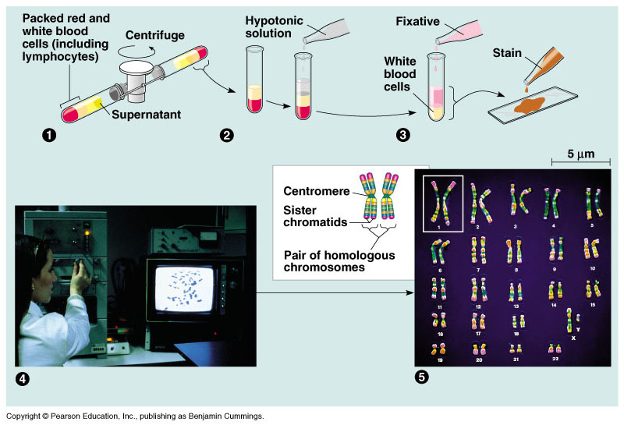

Slide 12
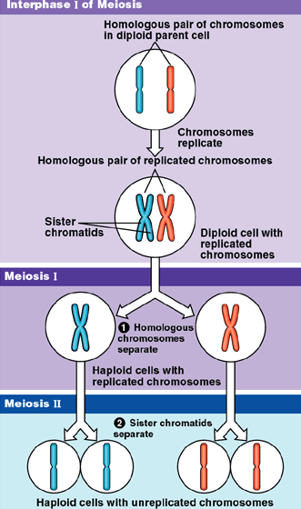
MEIOSIS
Occurs in germ cells
Germs cells (& somatic cells) are DIPLOIDS (2n)
For humans 2n=46
Germ cells undergo meiosis to form gametes (sperm & egg)
DIPLOID (2n) → HAPLOID (n)
2 sets of cell division:
  Meiosis I
  Meiosis II

Slide 13
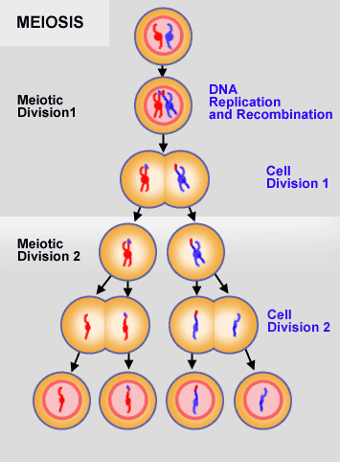
Meiosis I includes 4 stages:
Prophase I
Metaphase I
Anaphase I
Telophase I

Slide 14
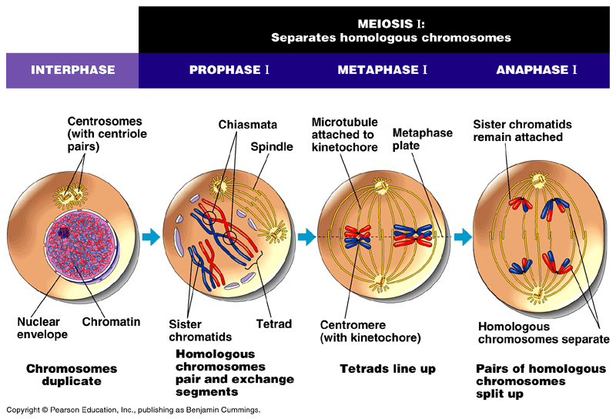

Slide 15
Meiosis II also encompasses four stages:
Prophase II
Metaphase II
Anaphase II
Telophase II
At the end of meiosis II, four daughter cells are produced. Each of these resulting daughter cells is haploid.

Slide 16
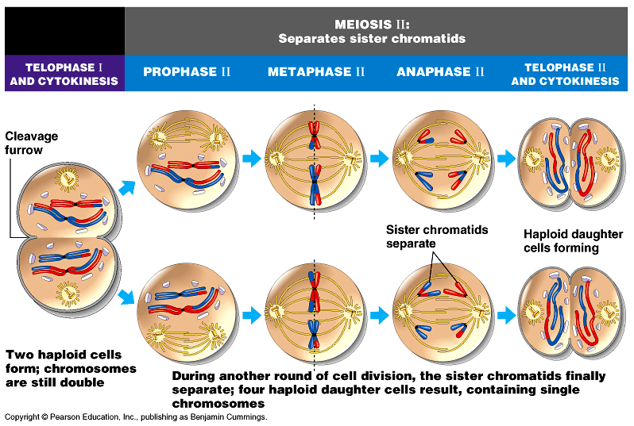

Slide 17
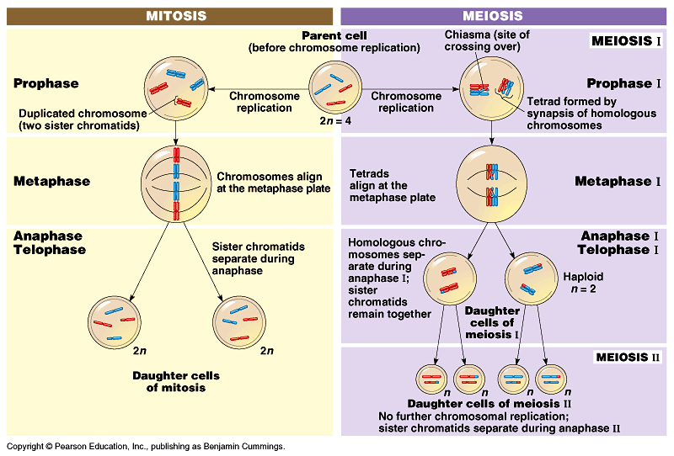

Slide 18
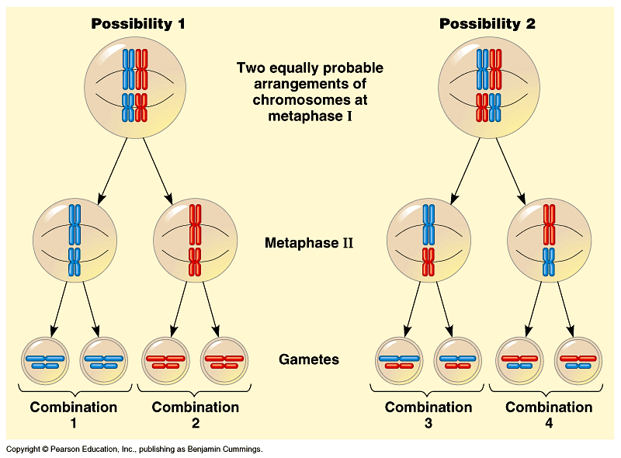
INDEPENDENT ASSORTMENT

Slide 19
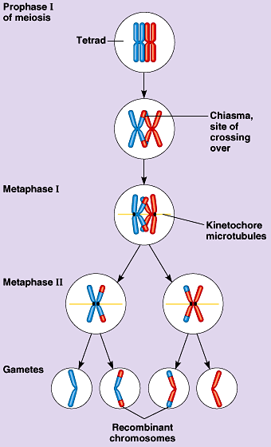
Crossing-Over
Occurs when homologous chromosomes “cross-over” one another and “swap” some DNA
Leads to variation in gametes

Slide 20
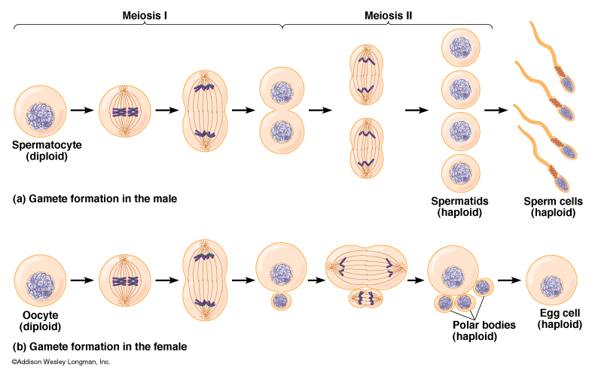
GAMETOGENESIS
spermatogenesis
oogenesis

Slide 21
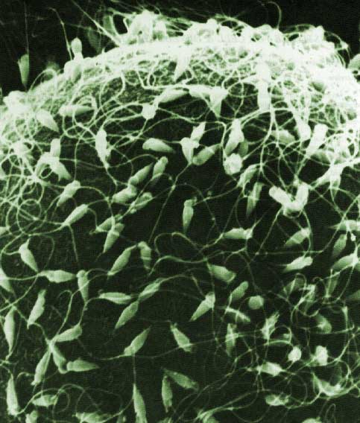

Slide 22
